Slide 1
Business Acceptance Solutions
Basic Design Elements:
Folded Self-Mailers
Notes:
Welcome to the presentation on Basic Design Elements for Folded Self-Mailers

Slide 2
Folded Self-Mailer: Defined
Business Acceptance Solutions
What is a Folded Self-Mailer?
A letter-size mailpiece formed by two or more panels that are created when one or more unbound sheets of paper are folded together and sealed.
Notes:
A folded self-mailer is formed of two or more panels that are created when one or more unbound sheets of paper are folded together and sealed to make a letter-size mailpiece. The number of panels is determined by the number of sheets in the mailpiece and the number of times the sheets are folded.

Slide 3
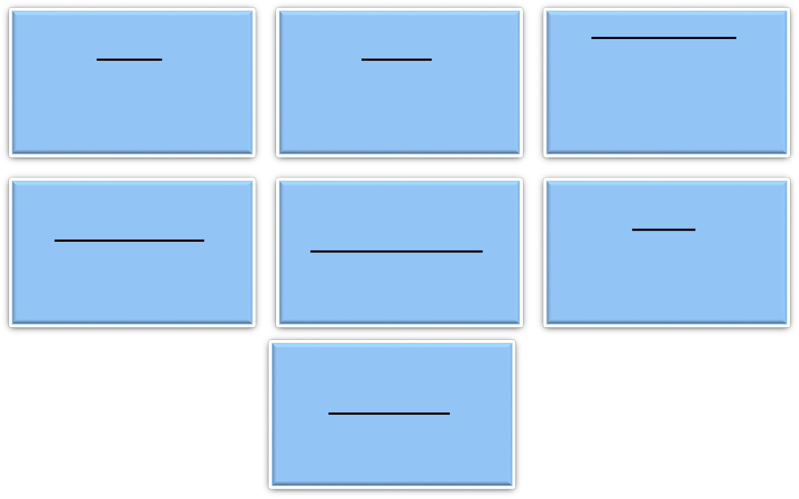
Folded Self-Mailers: Physical Characteristics
Business Acceptance Solutions
Min Thickness:
A minimum of 0.007 inch; (0.009 inch if the height exceeds 4-1/4 inches or if the length exceeds 6 inches)
Height:
A minimum of 3-1/2 inches and a maximum of 6 inches
Length:
A minimum of 5 inches and a maximum of 10- 1/2 inches
Max Thickness: The maximum thickness is 1/4 inch
Shape: Rectangular, with four square corners and parallel opposite sides
Maximum Weight: 3 ounces
Aspect ratio: Within 1.3 to 2.5
Notes:
Folded self-mailers must have the following characteristics:
Height: A minimum of 3-1/2 inches and a maximum of 6 inches.
Length: A minimum of 5 inches and a maximum of 10-1/2 inches.
Thickness: A minimum of 0.007 inch; (0.009 inch if the height exceeds 4-1/4 inches or if the length exceeds 6 inches); the maximum thickness is 1/4 inch.
Maximum Weight: 3 ounces.
Rectangular, with four square corners and parallel opposite sides.
Aspect ratio: within 1.3 to 2.5 (see DMM 201.3.7).
Maximum number of panels: 12, except under DMM 201.3.14.2h.
Quarter-folded self-mailers made of a minimum 70-pound paper basis weight or equivalent may have as few as 4 panels. Quarter-folded self-mailers made of 55 pound or greater newsprint must have at least 8 panels and may contain up to 24 panels.

Slide 4
Paper Weight & Sealing Requirements
Business Acceptance Solutions
The minimum basis weights and sealing requirements for 1- and 2-ounce folded self-mailers are:
Up to 1 ounce: 70-pound paper basis weight or equivalent sealed with a continuous glue line, three glue spots; or elongated glue lines; or two 1-inch tabs within one inch of each edge.
Over 1 ounce: 80-pound paper basis weight or equivalent sealed with a continuous glue line, four glue spots; or four elongated glue lines; or two 1-1/2 inch tabs within one inch of each edge.
Notes:
All references to folded self-mailer paper basis weight are for book-grade paper. Folded self-mailers up to 1 ounce and must be made of a minimum of 70-pound paper basis weight or equivalent and sealed with a continuous glue line, three glue spots; or elongated glue lines; or two 1-inch tabs.
Folded self-mailers over 1 ounce must be made of 80-pound paper basis weight or equivalent and sealed with a continuous glue line, four glue spots; or four elongated glue lines or two 1-1/2 inch tabs.
Please Note: Folded self-mailers with optional design elements must meet the standards in the DMM 201 3.14.5 c. & d.

Slide 5
Panels: Defined
Business Acceptance Solutions
What are Panels?
Panels are created when a sheet of paper is folded
Each two-sided section (front and back) created by the fold is considered one panel
How does a mailer identify the number of panels?
By the number of sheets in the mailpiece and the number of times the sheets are folded
Notes:
Panels are created when a sheet of paper is folded. Each two-sided section (front and back) created by the fold is considered one panel. When a folded self-mailer is made of multiple sheets, multiply the number of sheets by the number of panels created when folding a single sheet to determine the total number of panels.

Slide 6
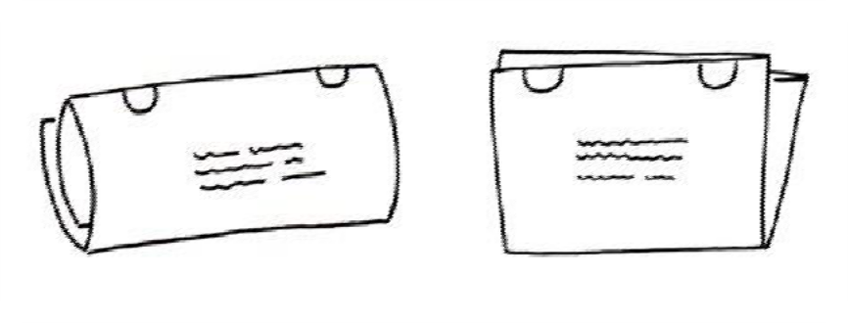
Folded Self-Mailers: Panels
Business Acceptance Solutions
Maximum number of panels =12, except under the following circumstances:
Quarter-folded self-mailers made of a minimum of 70- pound book grade paper may have as few as 4 panels
Quarter-folded self-mailers made of 55 pound or greater newsprint must have at least 8 panels and may contain up to 24 panels
Notes:
Folded self-mailers (FSMs) may have a maximum of 12 panels, except for quarter-fold self mailers made of 55 pound or greater newsprint; these FSMs must have at least 8 panels.
Quarter-folded self-mailers made of a minimum 70-pound paper basis weight or equivalent may have as few as 4 panels and quarter-folded self-mailers made of 55 pound or greater newsprint must have at least 8 panels and may contain up to 24 panels.

Slide 7
Requirements for Panels
Business Acceptance Solutions
Requirements
The open edge of the back panel must be at the top or within 1 inch of the top or trailing edge of the mailpiece
Internal shorter panels must be covered by a full-size panel, and count toward the maximum number of panels.
The final folded panel creates the back (non- address) side of the mailpiece
The final folded edge must be the bottom of a folded self- mailer unless prepared as an oblong
External panels created by folding must be nearly equal in size
8
Notes:
External panels created by folding must be equal or nearly equal in size. The final folded panel creates the back (non-address) side of the mailpiece. The open edge of the back panel must be at the top or within 1 inch of the top or trailing edge of the mailpiece. For horizontal folded tri-fold or multi-fold pieces, the addressed panel may be the final folded panel if the leading edge is sealed according to the standards in the DMM 201 3.14.4a. The final folded edge must be the bottom of a folded self-mailer unless prepared as an oblong. The final folded edge of an oblong folded self-mailer must be the leading (right) edge. Internal shorter panels must be covered by a full-size panel, and count toward the maximum number of panels. Optionally, internal shorter panels may be secured but must have only one edge that is shorter and be no further than one inch away from the edge of the external panel.

Slide 8
Panel Examples for Automation Folded Self-Mailers
Business Acceptance Solutions
Panel Count: address side view
2 Panels
( Bi-fold )
Single sheet folded once in half
4 Panels
Two nested sheets folded once in half One sheet folded three times
One sheet quarter-folded perpendicular
3 Panels
( Tri-fold )
Single sheet of
paper folded twice
…up to 12 panels for most designs
2
3
4
5
6
Notes:
The minimum number of panels in a folded self-mailer is two. This can only be achieved by folding a sheet of paper in half. This fold style is commonly known as a bi-fold although there is only a single fold.
Four panels can be created several ways. A single sheet quarter-folded will produce four panels as would a single sheet folded in one direction three times. Another method to create a four panel FSM is taking two nested sheets and folding them in half.
Another fold style is commonly known as a tri-fold which only has two folds that create three panels. The picture to the right is a horizontal folded tri-fold letter. The final panel must be folded from bottom to top. Tri-folds can also be vertical folds or oblong style; these require the final panel to be folded from lead to trail edge.

Slide 9
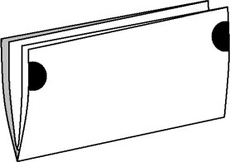
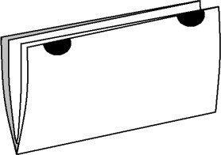
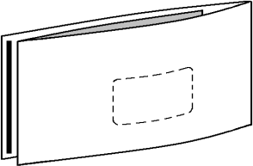
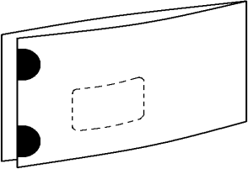
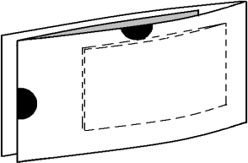
Fold Styles for Automation Folded Self-Mailers
Business Acceptance Solutions
Fold style / orientation: address side view
Horizontal: final fold at bottom edge to non-address side
Vertical: final fold on lead edge to non-address side
Oblong is a common name for this fold style
Notes:
Folded self-mailer fold patterns will be either horizontal or vertical in relation to the length of the mailpiece. For horizontal folded pieces, the final fold is always at the bottom with the final panel folded up to the top on the non-address side. Vertical folded pieces, commonly known as “oblong” have the final fold on the lead edge with the final panel folded from lead to trail edge on the non-address side.

Slide 10
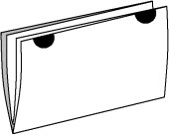
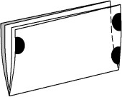
Closure Methods
Business Acceptance Solutions
Closure method - Glue
Continuous Glue Line
1/8” W to within 1/4” of each edge
Elongated Glue Lines
1/8” W x 1/2” L or
1/4” W x 1/2” L or
1/8” W x 1” L
3- 4 lines based on
mailpiece design / wgt
Glue Spots
3/8” diameter
3- 4 spots based on mailpiece design / wgt
Closure method - Tabs (2 or 3 based on mailpiece design)
Placed either at Top or Lead / Trail
within 1" from adjacent edge(s)
lower lead edge tab ½” from bottom
1” 1.5”
2”
1”
1.5”
2”
Notes:
Folded self-mailers may be sealed with a continuous glue line, glue spots, elongated glue lines or tabs. A proper closure is very important to ensure the mailpiece maintains physical integrity from transport, to entry, to delivery. Continuous glue lines are recommended; if using glue spots, which are round or irregularly shaped, or elongated glue lines which are line segments, a minimum of three are required. Four are required if the piece weight exceeds 1 ounce. The adhesive is placed on the edge opposite the final fold, or on the lead and trail edge for horizontal folded pieces, or along top and bottom of oblong pieces. The outer two spots or elongated glue lines are placed within ¼” of the edges, the third and fourth placed in line with the outer ones and are spaced evenly across the remaining space.
If tabs are used, they cannot be perforated or placed on the bottom edge. A minimum of two tabs are required. Three tabs may be required when the total weight is over 1 ounce and/or optional design elements are incorporated. Basic style FSMs under 1 ounce only require two 1” tabs. There are options available for tab placement. Both tabs can be placed along the edge opposite the final fold, so both can be placed at the top, or on trail edge of an oblong style FSM. For horizontal folded pieces, tab placement can also be one on the lead and the other on the trail edge, both within 1” from top. If a third tab is required, it must be placed on the lead edge within ½” from bottom.

Slide 11
Flaps for Automation Folded Self-Mailers
Business Acceptance Solutions
Flap: used for closure of mailpiece on non-address side
Horizontal fold Vertical fold
1.5” min flap
5” min flap Die-cut
No closer than 1”
to bottom edge
No closer than
1” to trail edge
Lead Edge on left
( Non-address side view )
Trail Edge on right
Notes:
Flaps on pieces with horizontal folds must be folded from top down on the non-address side. Flaps must be at least 1.5” long as measured at the longest point but cannot extend any closer than 1” from the bottom edge.
Like panels, flaps on vertical folded pieces are folded from the lead edge toward the trail edge. These flaps must be at least 5” long as measured at the longest point but cannot be any closer than 1” from the trail edge.
When sealing FSMs with a die-cut flap, we highly recommend the use of a glue line seal that follows the contour of the die-cut shape to create a solid seal.

Slide 12
Optional Design Elements –
Attachments
Business Acceptance Solutions
Outside attachments must be secured based on DMM 201.3.13.
Internal attachments
Must be secured to panel at least 1/2 inch from any edge
Multiple attachments must be nearly uniform in thickness
When multiple attachments are secured on separate panels, combined thickness is applied to maximum allowed if those attachments align stacked.
Where multiple attachments are placed adjacent across panel(s), thickest attachment applies to maximum allowed
Notes:
Attachments must be secured on the outside of a folded self-mailer in accordance with the standards in the DMM 201 3.13 (Labels, Stickers, Release Cards, and Perforated Pockets Affixed to the Outside of Letter-Size Mailpieces).
When attachments are secured within a folded self-mailer the attachment must be affixed to an inside panel and secured to it at least 1/2 inch from any edge. The attached material may not exceed a maximum thickness of 0.05 inch thick for mailpieces weighing up to 1 ounce and 0.09 inch thick for mailpieces weighing over 1 ounce. Multiple attachments must be positioned so that the host mailpiece remains nearly uniform in thickness.
When multiple attachments are affixed to separate panels in stacked alignment, the combined thickness of the attachments must be no greater than the maximum thickness in DMM 201.3.14.9b. When multiple attachments are affixed adjacent to each other across the length of a mailpiece, the thickest attachment must be no greater than the maximum thickness in DMM201.3.14.9b.

Slide 13
Optional Design Elements –
Die-Cut Windows
Business Acceptance Solutions
A die-cut element is a shape that is cut in paper through use of a
die-cut machine
Die-cut address windows (used to convey address information) must meet standards for window envelopes and meet the following additional conditions:
When an address
window appears on a
The maximum window size is 4 inches long by 2 inches high.
mailpiece, no other die-cut openings may be made on the exterior panels
Notes:
Folded self-mailers may be produced with two types of die-cut elements in the exterior panels, address windows or die-cut reveal. Die-cut openings may not be used to create die-cut punched holes (openings in the same location on all layers and panels so that there is a hole through the entire mailpiece).
Die-cut address windows (used to convey address information) must meet the standards for window envelopes outlined in the DMM 601.6.3 and meet the following additional conditions:
The maximum window size is 4 inches long by 2 inches high.
When an address window appears on a mailpiece, no other die-cut openings may be made on the exterior panels.

Slide 14
Optional Design Elements –
Die-Cut Reveal
Business Acceptance Solutions
Die-cut openings used to reveal the contents of the mailpiece must be:
Either circular with a 2-inch maximum diameter or rectangular with a maximum of 2 inches long by 1-1/2 inches high with slightly rounded 1/4 inch radius corners
Placed at least 1-1/2 inches from all edges of the mailpiece if on the addressed side
Limited to two on only one external panel.
Placed at least 5 inches from the leading edge and 1-1/2 inches from all other edges if on the non-addressed side
Positioned at least 1-1/2 inches apart when two or more die-cut openings are used
Notes:
The die-cut reveal option are openings used to reveal the contents of the mailpiece; these elements are limited to two on only one external panel and must be positioned at least 1-1/2 inches apart. They must be either circular with a 2-inch maximum diameter or rectangular with a maximum of 2 inches long by 1-1/2 inches high with slightly rounded 1/4-inch radius corners. These elements must be placed at least 1-1/2 inches from all edges of the mailpiece if on the addressed side and placed at least 5 inches from the leading edge and 1-1/2 inches from all other edges if on the non-addressed side.

Slide 15
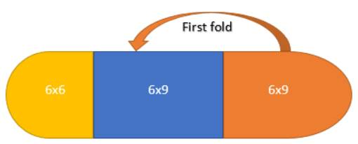
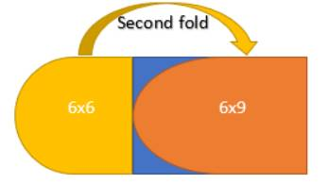
Business Acceptance Solutions
Optional Design Elements –
Die-Cut Reveal
Die-Cut Elements in Exterior Panels
Nonmachinable
DMM 201
3.14.6 Die-Cut Elements
Folded self-mailers may be produced with two types of die-cut elements in the exterior panels: address windows or die-cut reveal. Die-cut openings may not be used to create die-cut punched holes (openings in the same location on all layers and panels so that there is a hole through the entire mailpiece). Prepare die-cut elements as follows:
Notes:
In the example shown on this slide, the first folded panel appearing on the non-address side is considered an internal panel because it does not meet the Postal definition of being a nearly identical external panel (within one inch of the trailing edge – an external panel cannot contain a die-cut). As a result, the second folded panel must meet the Postal standards for nearly identical exterior panel and cannot contain a die-cut, reference USPS DMM Section 201.3.14.3b which it does not meet.
As a result, this planned Oblong letter-size FSM would be non-machinable as shown.
Now if the first folded panel had of met the nearly identical in size requirement for an exterior panel, the second folded panel could have then been considered a flap. At that point so long as the flap met the applicable construction requirement in DMM Section 201.3.14.3f4 and was properly sealed, the FSM would be considered machinable/automation compatible.

Slide 16
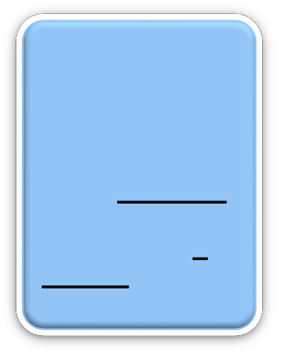
Optional Design Elements – Perforated Pull-Open Strips
Business Acceptance Solutions
Perforations, a row of small holes punched in a sheet of paper so that a section can be torn easily, are used to create pull-open strips, pop-out, or pop-open panes subject to the following requirements:
Position perforated strips
Two parallel
parallel to the height of the mailpiece at least 5 inches from the leading edge and 2 inches from the trailing edge
Position perforated strips parallel to the length of the mailpiece at least 1 inch from the top
Perforated
perforated lines must be spaced at least 1/2 inch apart creating a pull open strip
Perforations have a 1mm cut (max)/1mm tie (min) ratio
panes may not be prepared on pieces with die- cuts or on any mailpiece made of newsprint
Example perforations
Notes:
Folded self-mailers may be prepared with strips called panes that are pulled open to reveal the contents. These design elements must be placed only on the unaddressed side of the mailpiece and may be rectangular, circular, or oval shaped. Perforations, a row of small holes punched in a sheet of paper so that a section can be torn easily, are used to create pull-open strips, pop-out, or pop-open panes subject to the following requirements:
Two parallel perforated lines must be spaced at least 1/2 inch apart creating a pull open strip.
Position perforated strips parallel to the height of the mailpiece at least 5 inches from the leading edge and 2 inches from the trailing edge.
Position perforated strips parallel to the length of the mailpiece at least 1 inch from the top.
Perforations have a 1mm cut (max)/1mm tie (min) ratio.
Perforated panes may not be prepared on pieces with die-cuts or on any mailpiece made of newsprint.

Slide 17
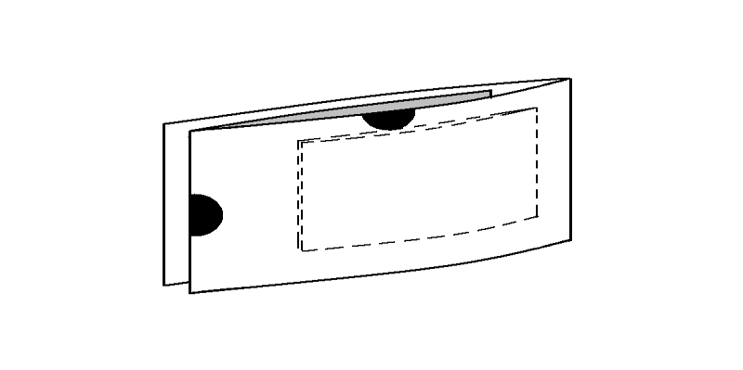
Optional Design Elements –
Pop-out Panes
Business Acceptance Solutions
Pop-out panes with perforations around the outer edges have a maximum size of 4 inches long by 4 inches high
The following conditions apply:
Place panes at least 1 inch from any edge
Use 1mm cut (max)/1mm tie (min) ratio
When using two panes, space them at least 1 inch apart
Address elements may not appear in perforated openings
Examples
Notes:
Pop-out, or pop-open panes (unaddressed side) are subject to the following requirements:
Pop-out panes with perforations around the outer edges have a maximum size of 4 inches long by 4 inches high. The following conditions apply:
Place panes at least 1 inch from any edge.
Use 1mm cut (max)/1mm tie (min) ratio.
When using two panes, space them at least 1 inch apart.
Address elements may not appear in perforated openings.
Pop-open panes with perforations on three sides must meet the following conditions:
The outer edges of the pull-open panel are a maximum of 4 inches long by 4 inches high.
If prepared with multiple panes, they must be spaced at least 1 inch apart.
Panes must be placed at least 1 inch from all edges.
Perforation patterns have 1 mm cut (max)/1 mm tie (min) ratio.

Slide 18
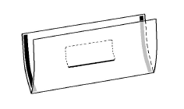
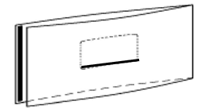
Optional Design Elements – Pop-open Panes
Business Acceptance Solutions
Pop-open panes with perforations on three sides must meet the following conditions:
The outer edges of the pull-open panel are a maximum of 4 inches long by 4 inches high.
If prepared with multiple panes, they must be spaced at least 1inch apart.
Panes must be placed at least 1 inch from all edges.
Perforation patterns have 1 mm cut (max)/ 1 mm tie (min) ratio.
Notes:
Pop-open panes may have perforations on three sides. The outer edges of the pull-open panel may be a maximum of 4 inches long by 4 inches high. If the FSM is prepared with multiple panes, they must be spaced at least 1 inch apart. Panes must be placed at least 1 inch from all edges and perforation patterns must have 1 mm cut (max)/1 mm tie (min) ratio.

Slide 19
Optional Design Elements –
Loose Enclosures
Business Acceptance Solutions
Loose enclosures must be made of paper and must meet the following conditions:
Folded self- mailers with die- cut openings may contain enclosures only if the inserted material is larger than the die-cut opening
Inserted in an interior pocket or secured by any method that prevents excessive shift
Maximum enclosure thickness: 0.05 inch thick for mailpiece weights up to 1 ounce.
Maximum enclosure thickness: 0.09 inch thick for mailpiece weights over 1 ounce
Contained securely within the mailpiece.
Notes:
Folded self-mailers with loose enclosures must be securely sealed to ensure containment of the enclosed material and prevent excessive enclosure shift during processing.
Loose enclosures must be made of paper and must be contained securely within the mailpiece.
Loose enclosures must be inserted in an interior pocket or secured by any method that prevents excessive shift during normal handling. Pockets are not counted as panels.
Folded self-mailers with die-cut openings may contain enclosures only if the inserted material is larger than the die-cut opening.
Enclosed material does not exceed the maximum thickness of:
0.05 inch thick for mailpiece weights up to 1 ounce.
0.09 inch thick for mailpiece weights over 1 ounce.

Slide 20
ADDITIONAL RESOURCES
Business Acceptance Solutions
Visit our websites at: www.usps.com Postal Explorer - http://pe.usps.gov/
Contains the DMM, IMM and various publications.
PostalPro -
https://postalpro.usps.com/
Contains information on Intelligent Mail, Full-Service, eInduction, Seamless Acceptance, etc.
36

Slide 21
Business Acceptance Solutions
MDA SUPPORT CENTER
Contact Information: Phone - 855-593-6093 OR
Email - MDA@USPS.GOV
MONDAY – FRIDAY, 7am – 7pm CST
37

